Slide 1
Integrated Design and Analysis of a G+7 Building: Leveraging AutoCAD, Revit, ETABS, and RCDC for Civil Engineering Excellence

Slide 2
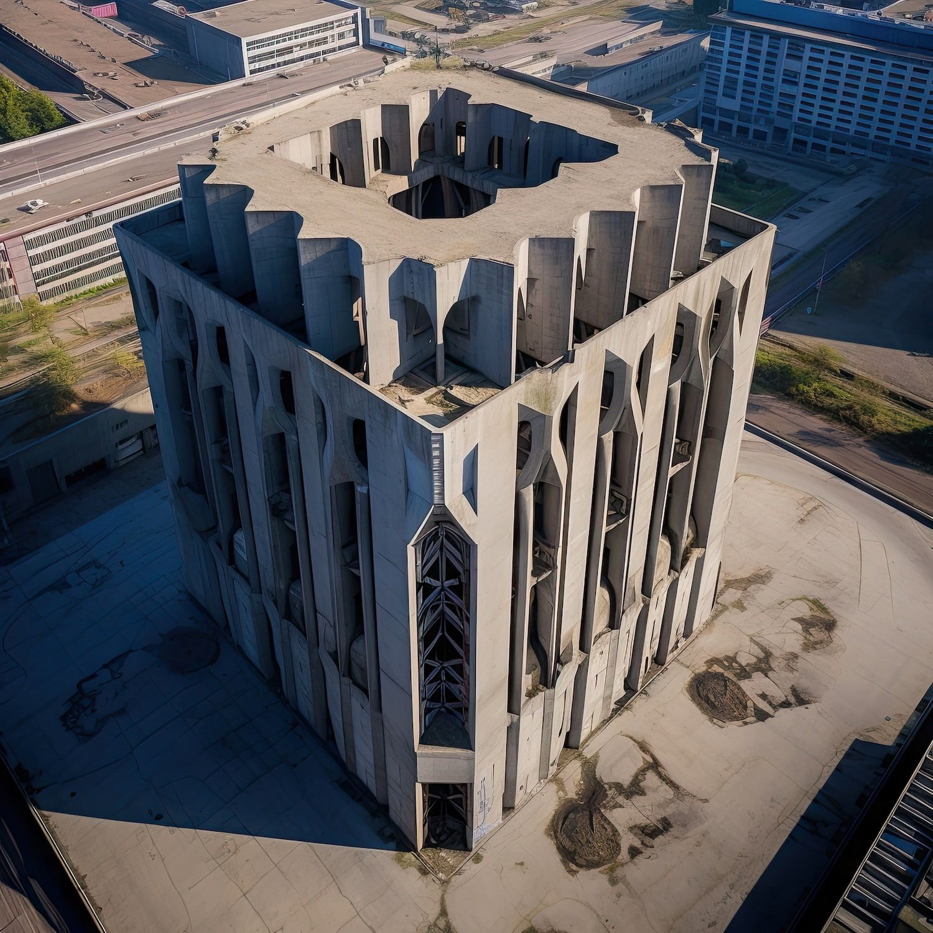






Introduction
This presentation explores the integrated design and analysis of a G+7 building. We will leverage tools like AutoCAD, Revit, ETABS, and RCDC to demonstrate how these technologies enhance civil engineering practices and improve project outcomes.

Slide 3
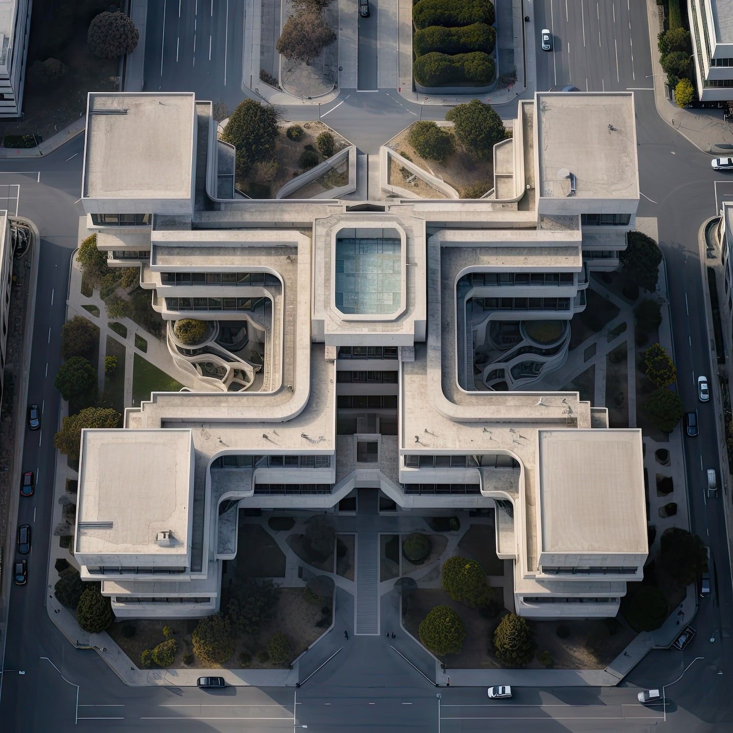






Project Overview
The project involves designing a G+7 building that meets modern architectural standards. By integrating design and analysis, we aim to optimize structural integrity and aesthetic appeal, ensuring compliance with local building codes and regulations.

Slide 4
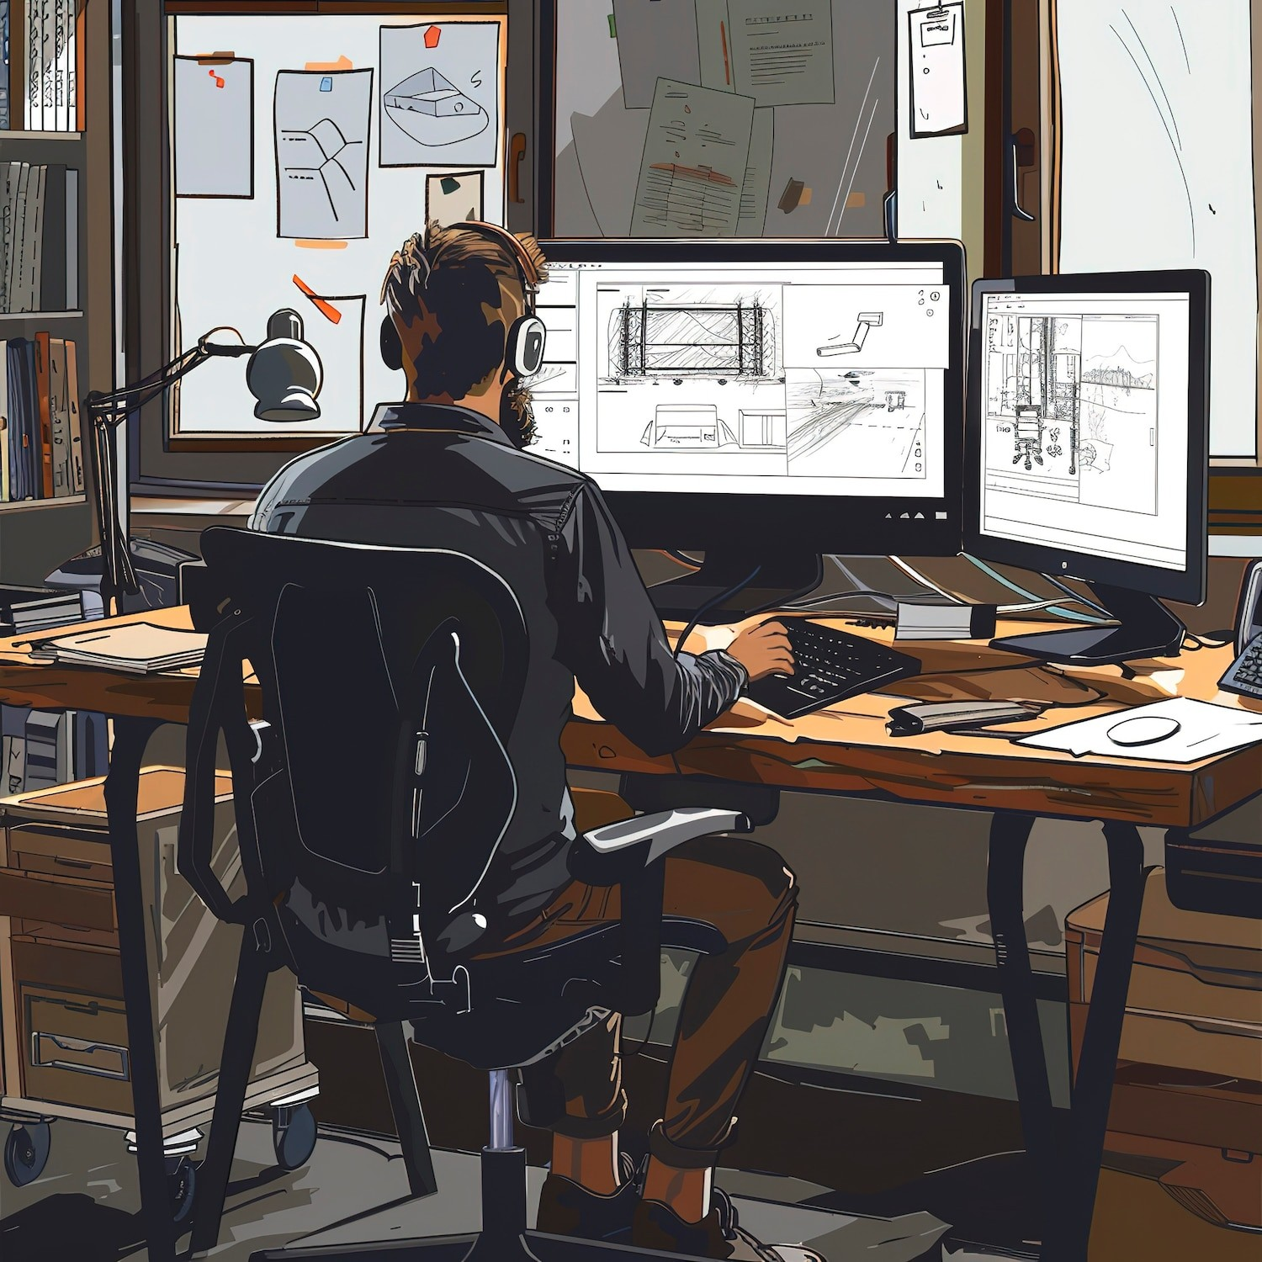




AutoCAD for Design
Using AutoCAD, we create precise 2D and 3D drawings. This software allows for the efﬁcient drafting of architectural plans, ensuring accuracy in dimensions and facilitating collaboration among design teams throughout the project.

Slide 5
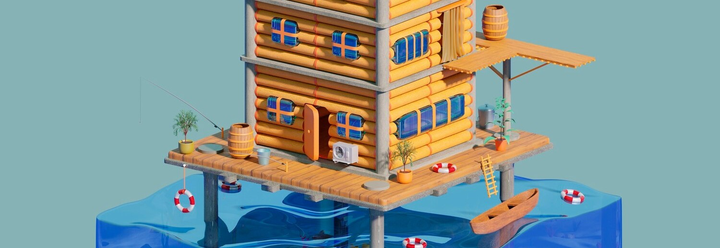
Revit enhances the design process through Building Information Modeling (BIM). It allows for real-time updates and coordination among various disciplines, improving collaboration and reducing errors in the design phase of the G+7 building.

Slide 6
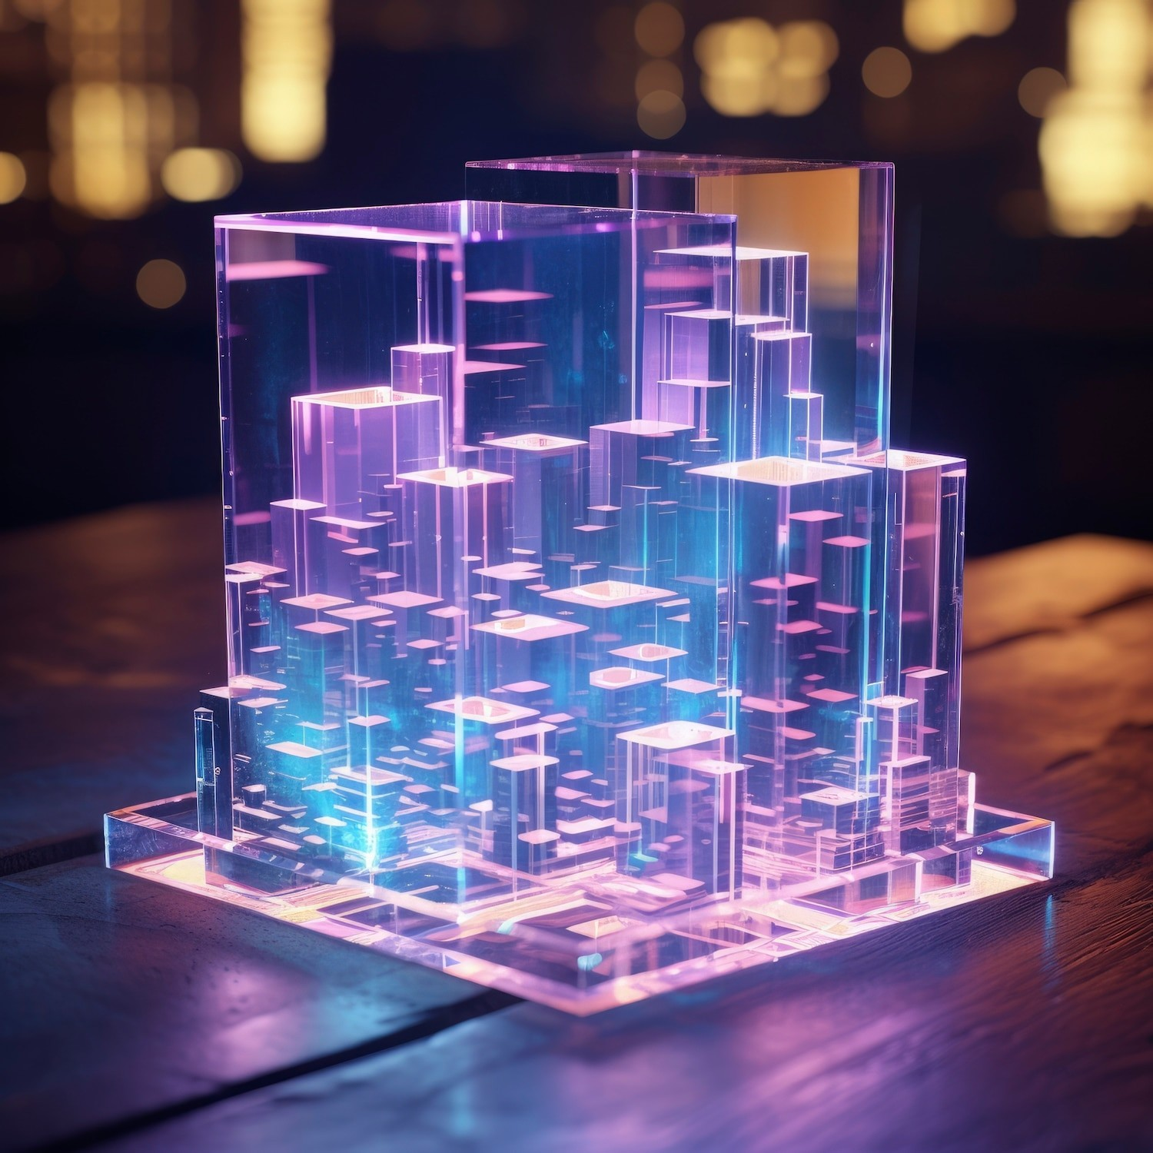

Structural Analysis with ETABS
ETABS is utilized for comprehensive structural analysis of the building. It aids in evaluating the performance of structural elements under various loads, ensuring safety and compliance with engineering standards throughout the building's lifecycle.

Slide 7



Design Detailing in RCDC
RCDC focuses on the detailing of reinforced concrete structures. This software streamlines the design process by automating the calculation of reinforcement details, thus enhancing the overall efﬁciency and accuracy of the structural design.

Slide 8





The integration of AutoCAD, Revit, ETABS, and RCDC fosters interdisciplinary collaboration. By sharing models and data across platforms, teams can work together more effectively, addressing challenges proactively and improving project timelines.

Slide 9
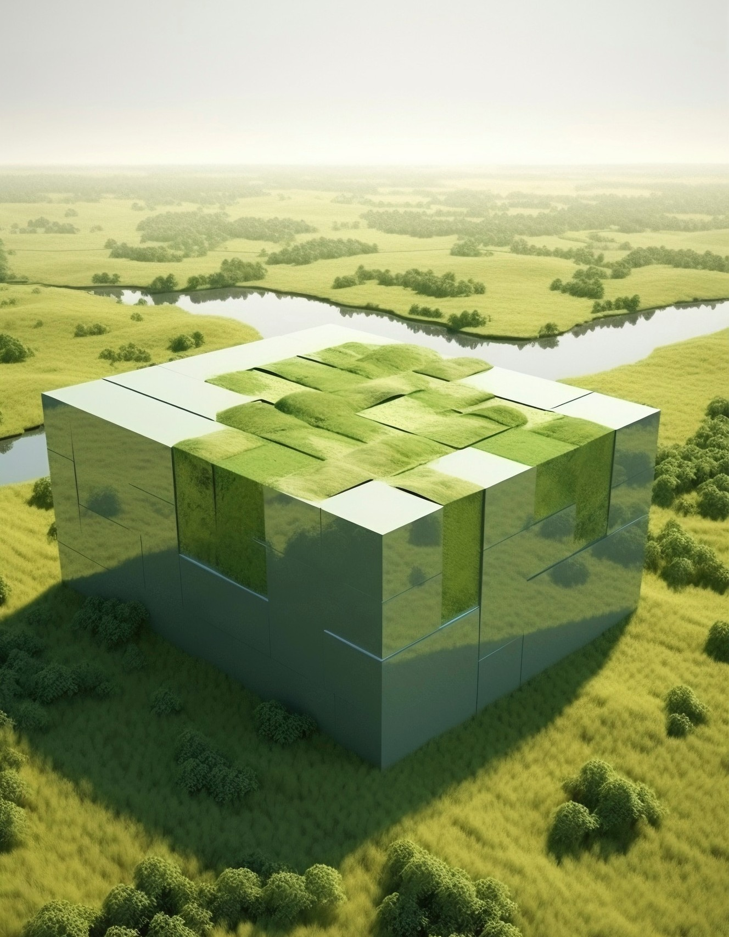



Sustainability Considerations
Incorporating sustainability into the design is crucial. By using these integrated tools, we can analyze energy performance, optimize material usage, and ensure that the G+7 building adheres to green building standards for environmental impact.

Slide 10
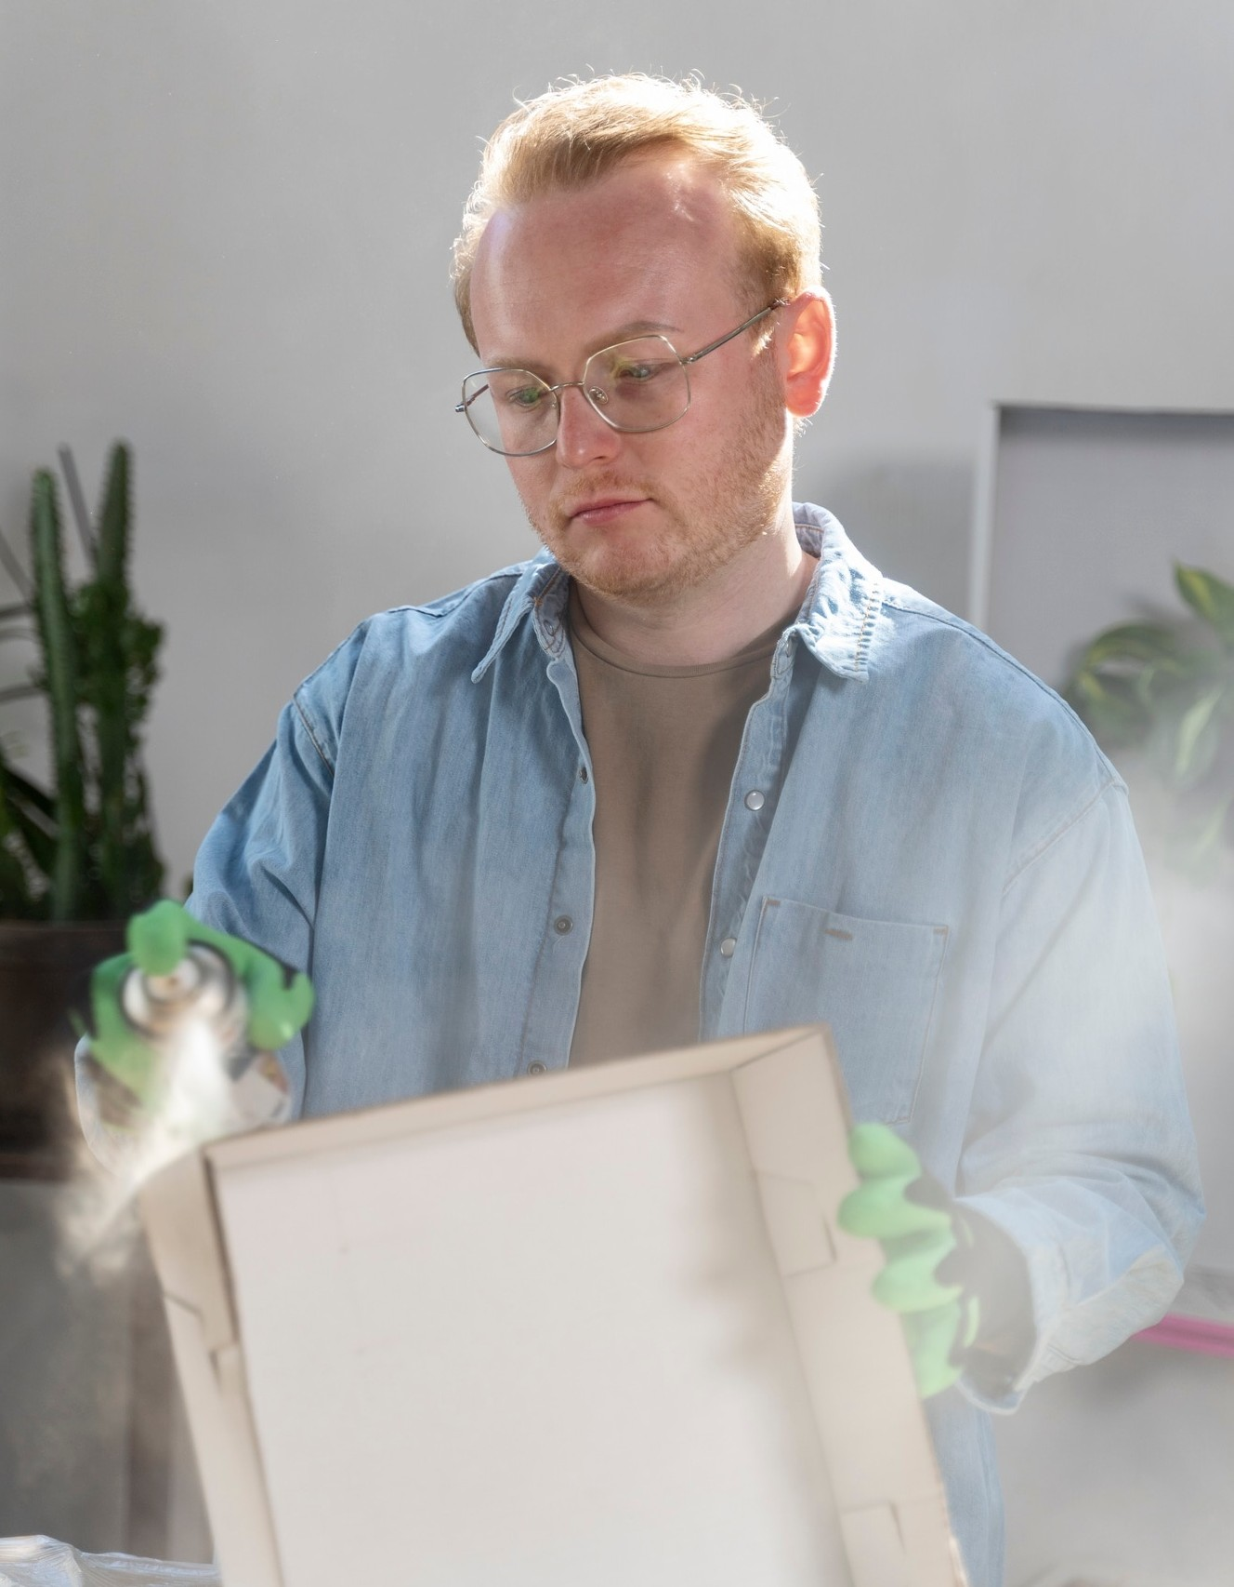
Challenges Faced
Throughout the project, we encountered challenges such as design discrepancies, software integration issues, and meeting tight deadlines. Addressing these challenges required effective communication and problem-solving strategies among all team members.

Slide 11
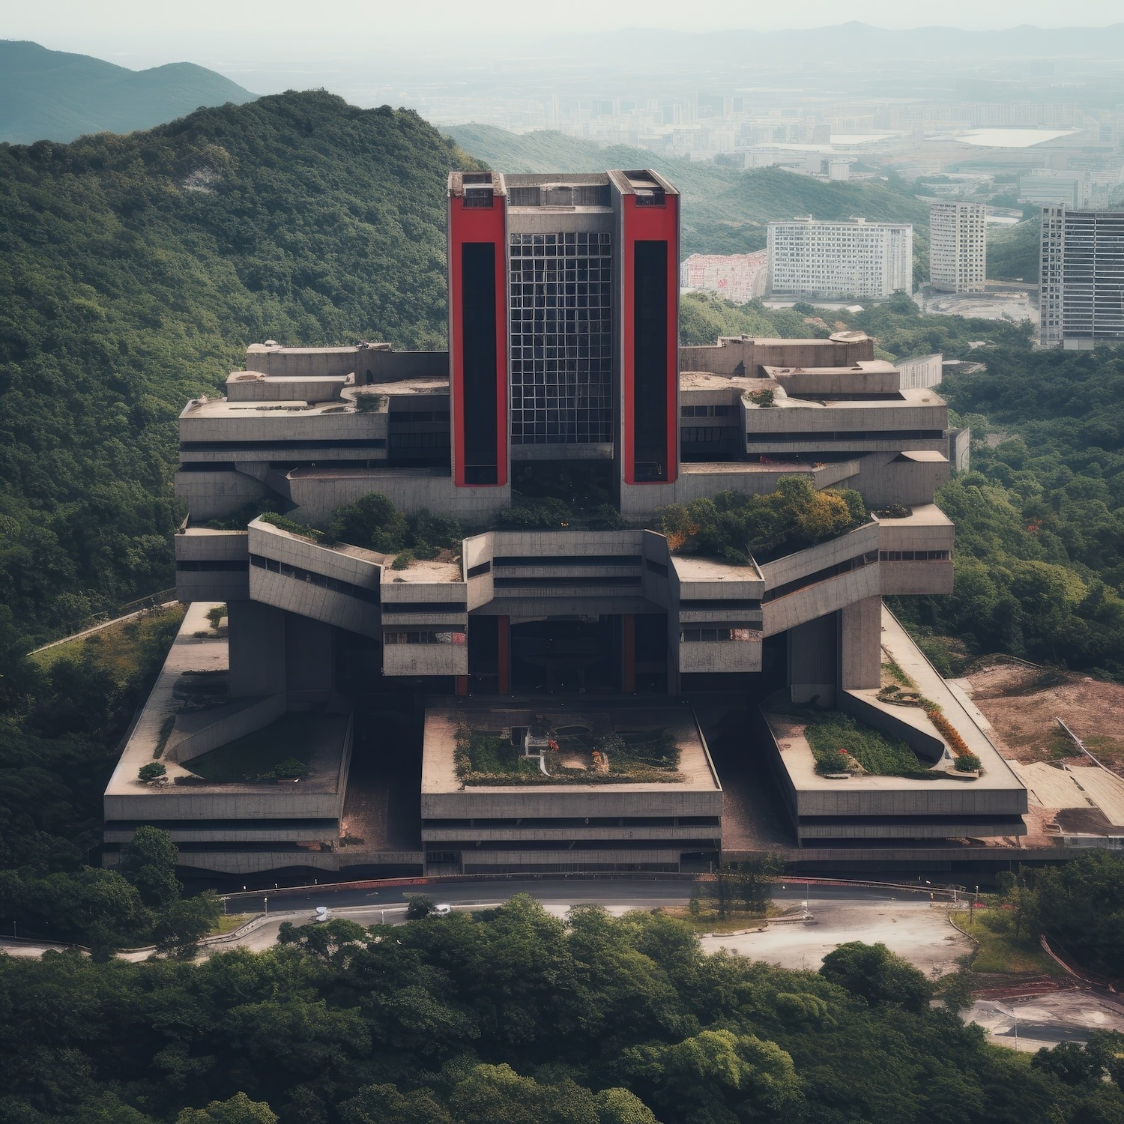


Case Study: Success Story
We present a case study highlighting a successful G+7 project where the integrated approach led to a reduction in costs and improved project delivery time. This demonstrates the effectiveness of using advanced software tools in civil engineering.

Slide 12


Future Trends
Looking ahead, the integration of AI and machine learning with design software will further revolutionize the construction industry. Embracing these technologies will lead to smarter, more efﬁcient building practices and enhanced project outcomes.

Slide 13
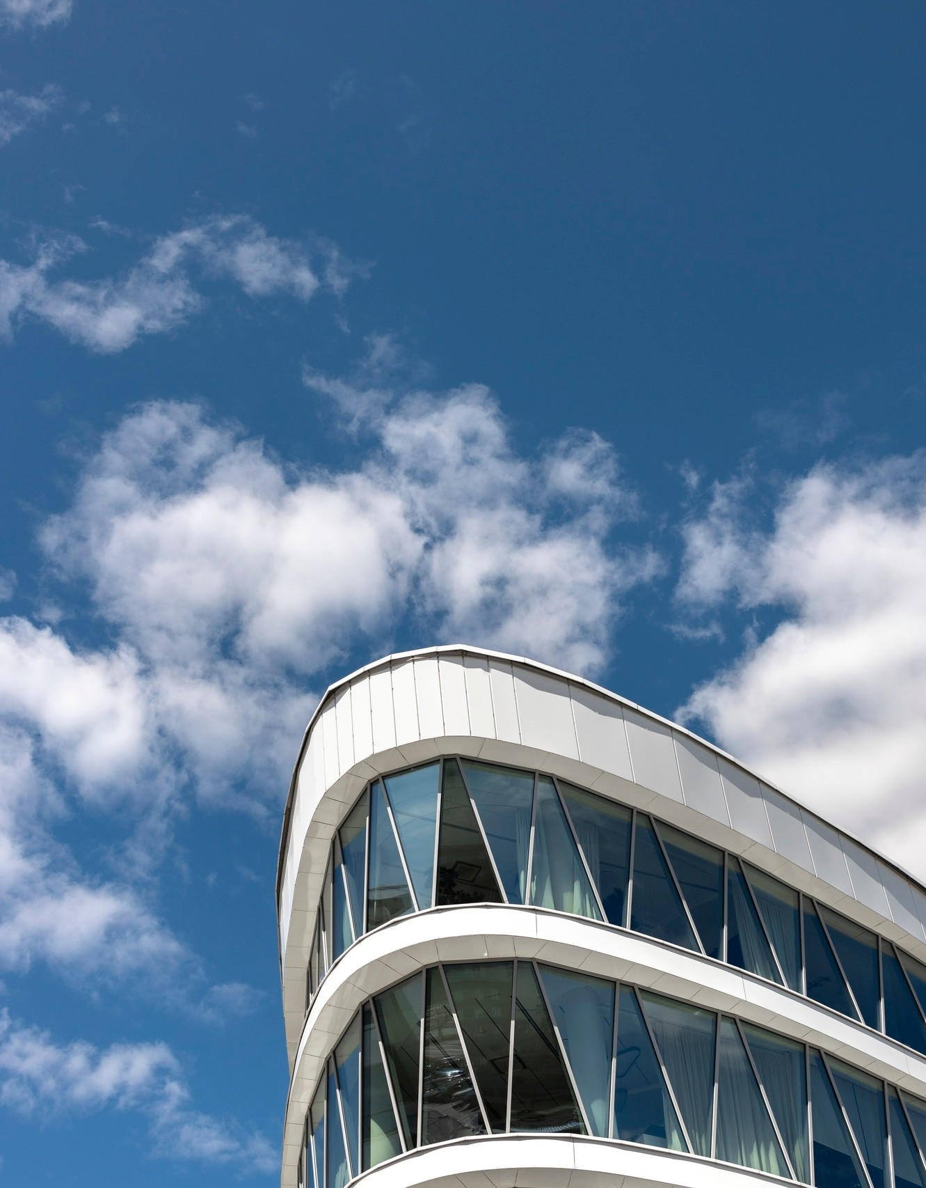


Conclusion
In conclusion, leveraging AutoCAD, Revit, ETABS, and RCDC in the integrated design and analysis of a G+7 building signiﬁcantly enhances civil engineering excellence. This approach not only improves efﬁciency but also ensures high-quality standards in construction.

Slide 14
Thanks!
Do you have any questions? youremail@email.com
+91 620 421 838
www.yourwebsite.com @yourusername

